Slide 1
Quality Based Procedure for
Low Risk Birth:
Clinical Recommendations
Version: May 15/18
Clinical Education Package

Slide 2
QBP for Low Risk Birth
Introduction

Slide 3
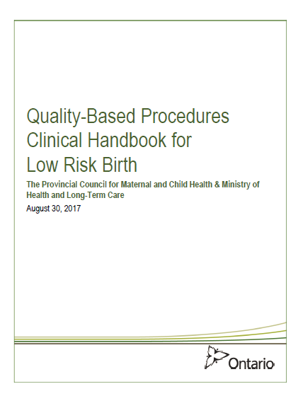
Purpose of this Presentation
To review the clinical recommendations of the Low Risk Birth Quality-Based Procedure (QBP)

Slide 4

What is a QBP?
QBPs are an integral part of Ontario’s Health System Funding Reform (HSFR), a key component of Patient-Based Funding and plays a key role in advancing the government of Ontario’s quality agenda and it’s Action Plan for Health Care.
HSFR allocates funds based on a price, volume and quality approach, premised on evidence-based practices and available data. It been identified as an important mechanism to strengthen the link between the delivery of high quality care and fiscal sustainability.

Slide 5

Why is this Important?
This QBP was developed as a part of Ontario’s Health System Funding Reform (HSFR) to:
Promote normal birth
Address the variation in Caesarean Section (CS) rates across the province in the low risk mother
Improve patient outcomes via focusing on the delivery of standardized, evidence-informed practices
Hospital funding changes with regards to how low risk births will be remunerated are planned for the 2019/20 fiscal year.
2018/19 will be a year for clinical adoption.

Slide 6

Resources
For more information refer to the Low Risk Birth QBP Toolkit and the QBP Handbook for Low Risk Birth.
BORN Ontario will be developing a data report to support the implementation of the clinical recommendations.
PCMCH will be hosting a series of webinars including one focused on funding and related questions (Winter 2018/19).
Information and resources available at: www.pcmch.on.ca

Slide 7
QBP for Low Risk Birth
Context

Slide 8
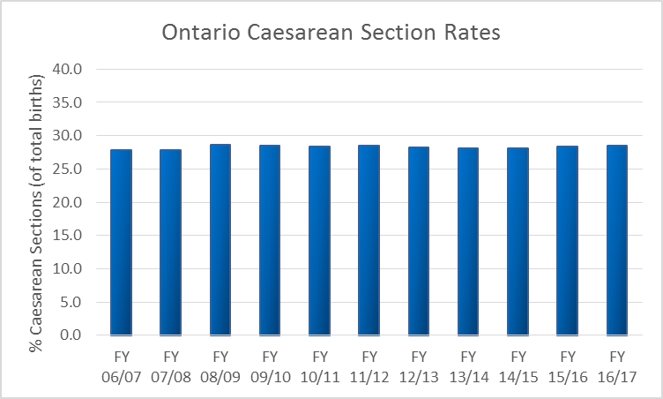
Background – Caesarean Section Rates
BORN Ontario (2006-2017)
Notes:
This slides shows that for the past 10 years (2006-2017) the average caesarean section (CS) rate in Ontario has remained relatively stable, between 27-28% for all women who delivered in Ontario.

Slide 9
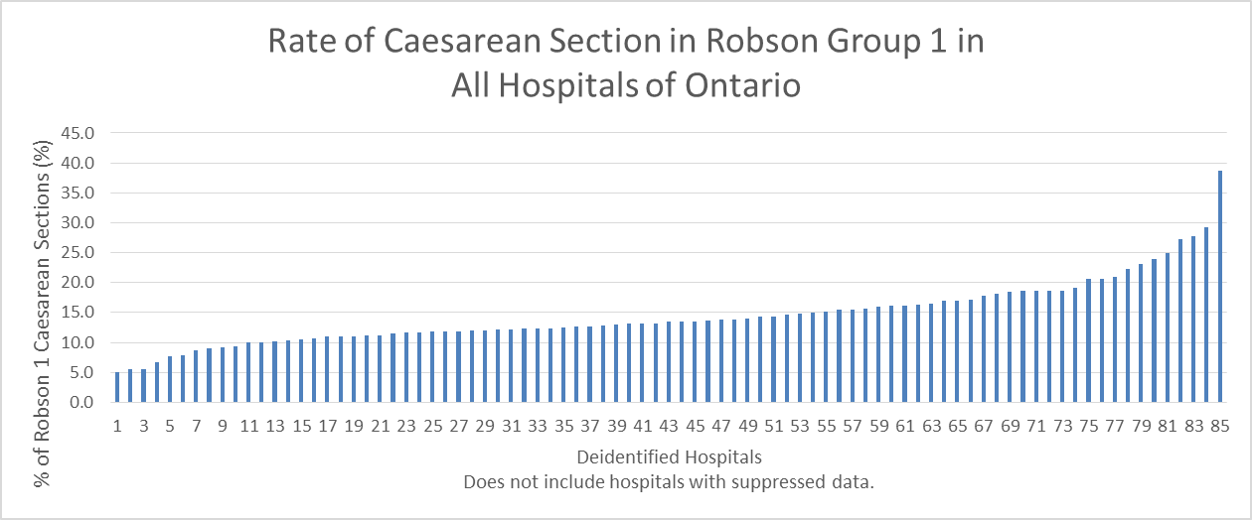
Background – Caesarean Section Rates
BORN Ontario (April 2009 – March 2014)
Does not included hospitals with suppressed numbers.
Notes:
This slide shows, however, that between 2009 and 2014, CS rates for low risk women varied significantly by hospital, from 5% to as high as 38%.
Low risk defined as women in Robson Group 1 (Nulliparous, singleton cephalic, > 37 weeks, spontaneous labor), aged 20-34.

Slide 10
POLL
Which one of the below is the highest reported primary indication for caesarean section?
  Atypical or Abnormal Fetal Surveillance
  Repeat Caesarean Section
  Malposition
  Nonprogressive first stage
  Nonprogressive second stage
Appendix A, QBP Handbook (BORN Ontario data)
Notes:
Full list of primary indications for CS is available in appendix A of the QBP Handbook.

Slide 11
POLL
Which one of the below is the highest reported primary indication for caesarean section?
  Atypical or Abnormal Fetal Surveillance
  Repeat Caesarean Section
  Malposition
  Nonprogressive first stage
  Nonprogressive second stage
14.9%
35.2%
12.1%
10.7%
5.4%
Appendix A, QBP Handbook (BORN Ontario data)
Notes:
Full list of primary indications for CS is available in appendix A of the QBP Handbook.

Slide 12
Complications of Caesarean Section
 | Vaginal birth | Caesarean birth
Overall severe morbidity | 8.6% | 9.2%
Maternal mortality | 3.6/100 000 | 13.3/100 000
Amniotic fluid embolism | 3.3-7/100 000 | 15.8/100 000
3rd and 4th degree tears | 1-3%
Urinary incontinence | No difference at 2 years | No difference at 2 years
Source:
ACOG 2014, Obstetric Care Consensus: Safe Prevention of the Primary Cesarean Delivery
California Maternal Quality Care Collaborative, 2017. Toolkit to Support Vaginal Birth and Reduce Primary Cesareans

Slide 13
Long Term Risks of Caesarean Section
Repeat Caesarean sections
Abnormal placentation
Adhesions
Uterine rupture
Bowel obstruction
Neonates may have
Increased NICU admissions
Difficulty with breast feeding
Increased asthma
Source:
California Maternal Quality Care Collaborative, 2017. Toolkit to Support Vaginal Birth and Reduce Primary Caesareans

Slide 14
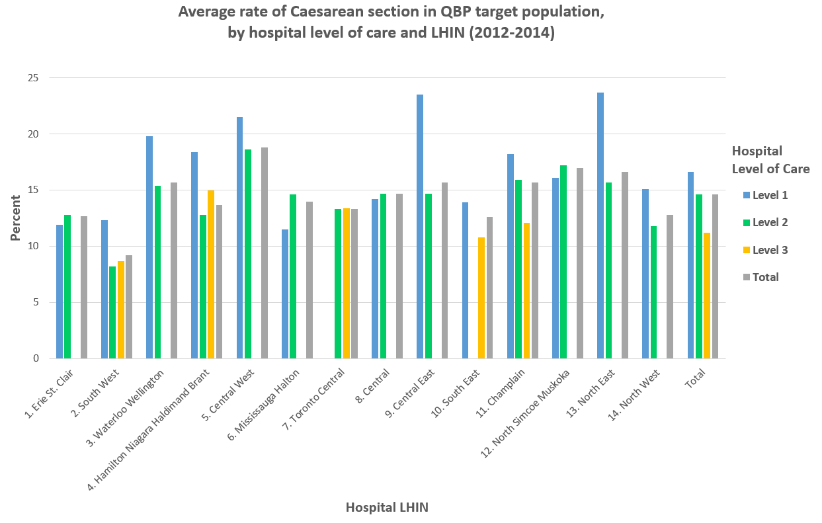
BORN Ontario (2012-2014)
Notes:
This slides demonstrates the variation in CS rates across LHINs and Levels of Care by the QBP target population group
‘QBP Target population’ includes:
<36 years of age at the time of delivery
Pre-pregnancy BMI <40.0 kg/m2
Nulliparous
Singleton gestation with cephalic presentation
Delivery ≥ 37 weeks of gestation
Spontaneous labour
Several maternal and fetal health conditions were excluded in order to ensure a homogeneous and comparable cohort. See QBP Appendix B or Slide 18.

Slide 15

Do you know the Caesarean section rate for your hospital?
BORN Ontario (April 2009 – March 2014)
Does not included hospitals with suppressed numbers.
Notes:
This slide shows CS variation by hospital in low risk women. The range is from 5% to as high as 38%.
(Robson 1 – Nulliparous, singleton cephalic, > 37 weeks, spontaneous labor), aged 20-34 yrs.
Do you know where your hospital CS rate falls for this population?

Slide 16
Description of the QBP
The goal of the Low Risk Birth QBP is to reduce the variation in Caesarean section rate in low risk women via the adoption of evidence-based guidelines that promote vaginal birth.
  Any reduction in primary Caesarean section will also positively impact the rate of repeat Caesarean section.
Notes:
The objectives of this QBP are to:
Provide clinicians with evidence-based recommendations regarding management of low risk pregnancies from preconception and into the postpartum period;
Promote standardized management of low risk pregnancies from preconception and into the postpartum period;
Reduce variation in the rate of CS;
Promote postpartum recovery and optimal length of stay and early discharge when appropriate

Slide 17
Inclusion Criteria
The Expert Panel focused on a homogeneous group for whom the evidence supports specific interventions that are likely to promote vaginal birth
The patient cohort defined for this QBP was comprised of women with the following characteristics:
  Robson 1
    Nulliparous
    Singleton gestation with cephalic presentation
    Delivery ≥ 37 weeks of gestation
    Spontaneous labour
  <36 years of age at the time of delivery
  Pre-pregnancy BMI <40.0 kg/m²
  No medical or fetal complications of pregnancy
Notes:
The Expert Panel that developed this QBP recommends a focus on the low-risk, first-time mother in spontaneous labour (Robson Group 1). This focus provides a homogeneous group that is applicable to all levels of maternity care and for which there are evidence-based standards of care that promote vaginal birth. In addition, any reduction in primary CS section will positively impact the rate of repeat CS.
The Expert Panel recognizes that although this QBP has been developed for the above mentioned target population, it can also be used to promote vaginal birth in women outside of this group.

Slide 18
Exclusion
Criteria
Classification of Disorders | Specific Condition
Maternal Health Conditions
Autoimmune | Lupus; Rheumatoid Arthritis; Autoimmune Other
Cancer | Diagnosed in Pregnancy; Medication exposure in pregnancy – Chemotherapeutic Agents
Cardiovascular | Acquired Heart Disease; Antihypertensive Therapy Outside of Pregnancy; Cardiovascular Disease; Congenital Heart Defect; Congenital Heart Disease; Pre-existing Hypertension; Renal Disease; Cardiovascular Other
Diabetes | Diabetes and pregnancy
Gastrointestinal | Liver/ Gallbladder - Cholecystitis; Colitis; Crohn’s; Hepatitis; Liver/ Gallbladder - Intrahepatic Cholestasis of Pregnancy
Genitourinary | Acquired Renal (Insufficiency - Chronic Infections); Congenital/ Genetic Renal (Renal Agenesis – Pelvic Kidney); Renal Disease; Uterine Anomalies; Genitourinary Other
Haematology | Gestational Thrombocytopenia; Haemophilia (A and B Von Willebrand); Idiopathic Thrombocytopenia; Sickle Cell Disease; Thalassemia; Thrombophilia; Haematology Other
Hypertensive Disorders in Pregnancy | Gestational Hypertension; Eclampsia; HELLP; Preeclampsia; Preeclampsia Requiring Magnesium Sulfate; Pre-existing Hypertension with Superimposed Preeclampsia; Maternal Unknown
Musculoskeletal | Achondroplasia; Muscular Dystrophy/ Neuromuscular Disorder; Myotonic Dystrophy; Osteogenesis Imperfecta; Musculoskeletal Other
Neurology | Cerebral Palsy; Multiple Sclerosis; Myasthenia Gravis; Spina Bifida/ Neural Tube Defect; Neurology Other
Pulmonary | Cystic Fibrosis; Previous Pulmonary Embolism/ Deep Vein Thrombosis; Pulmonary Hypertension; Pulmonary Other
Complications of Pregnancy
Placental | Placenta Accreta; Placenta Increta; Placenta Percreta; Placenta Previa; Placental Abruption; Placental Other
Fetal Health Conditions
Fetal Complications | Anomalies; Isoimmunization/ Alloimmunization; Intrauterine Growth Restriction; Oligohydramnios; Fetal therapy – Fetal surgery
Maternal and fetal complications that can increase the risk of Caesarean section
Can be captured in BORN database

Slide 19
QBP for Low Risk Birth
Clinical Recommendations

Slide 20
QBP Clinical Recommendations
The scope of recommended interventions that may impact the risk of Caesarean section include: pre-pregnancy phase to post- delivery management as well as retrospective evaluation
1. Pre-pregnancy Phase
2. Antenatal Phase
3. 37 to 41 Weeks
4. Management of Labour
5. Post-delivery
Management
6. Retrospective Evaluation/Review
PHASE 1 PHASE 2 PHASE 3 PHASE 4 PHASE 5 PHASE 6
Notes:
The following phases are included in the clinical recommendations. They will be described and salient points highlighted. For detailed regarding each recommendation please refer to the QBP toolkit and the Clinical Handbook.

Slide 21





Pre-Pregnancy Recommendations
PHASE 1
1.1 Increase knowledge and awareness about healthy pregnancy through healthcare provider – patient conversation and engagement with other agencies
Notes:
Some examples of reputable resources are:
MotHERS Program – This Ontario-based website provides information to women contemplating pregnancy, are pregnant or are now new mothers keep up-to-date on the latest medical information. Includes links to other resources and mobile apps to track baby’s fetal movements and mother’s health.
OMama– OMama is an innovative tool to support and inform effective care, developed and owned by the Better Outcomes Registry & Network (BORN) Ontario. OMama contains information on over 100 topics, curated by Ontario experts from across a range of disciplines. The website and mobile app enable access to information on pregnancy, birth, postpartum, and early parenting.
The Society of Obstetricians and Gynaecologists of Canada (SOGC) website – This website provides evidence based information about pregnancy and childbirth to the Canadian public and healthcare professionals. All material on this website are developed by doctors, nurses, and midwives and is based on guidelines from the SOGC.
Association of Ontario Midwives (AOM) website – This website includes information to the public about midwifery care and helpful resources and information on pregnancy.
Healthy Beginnings – This book was developed by the SOGC, Best Start Resource Centre and the Canadian Paediatric Society. This comprehensive prenatal resource is designed to meet the information needs of couples planning a pregnancy, pregnant women and new parents.
The Healthy Pregnancy Guide – This guide was developed by the Public Health Agency of Canada (PHAC) and will provide women with accurate information to help them make good decisions about how to take care of themselves before, during and after their pregnancy.

Slide 22

Antenatal Phase Recommendations
PHASE 2
2.0 Inform women that appropriate weight gain and regular exercise appear to decrease risk of Caesarean section (CS)
Normal weight – 11.5 - 16.0 kg (25 - 35 lbs) is recommended
Overweight – 7.0 - 11.5 kg (15 - 25 lbs) is recommended
Class I/II Obese – 7.0 kg (15 lbs) is recommended
3.0 Recommend routine dating ultrasound to attain the best estimate of the expected date of delivery
4.0 Counsel women about practices that support vaginal birth
Notes:
2.0 Weight/Exercise
Women without contraindications should be encouraged to participate in aerobic and strength-conditioning exercises
Women should be advised that adverse pregnancy and neonatal outcomes are not increased in exercising women
3.0 Ultrasound
More accurate than a certain LMP in the first and second trimesters <23weeks
Reduces inductions for post-term
Ideally, done in first trimester, unless availability is limited it is reasonable to be done in the 2nd trimester
4.0 Counselling
Women should be informed about what it means to be at term and post-term (due date vs. latest date of delivery), and the patient and provider practices during this period that support vaginal birth
Women should be offered information on the benefits, limitations, indications, and risks of intermittent auscultation and electronic fetal monitoring during labour.
Patient information materials will be forthcoming

Slide 23
Engage women in discussion to decrease the chance of Caesarean section
Discuss…
Healthy weight gain
How latent phase admission is associated with higher rates of CS
Pain management strategies in latent phase to support staying at home longer
Benefits of continuous labor support
Positioning
Benefits of intermittent auscultation (IA)

Slide 24
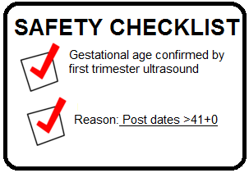
37 to 41 Weeks Recommendations
PHASE 3
5.0 Perform induction of labour (IOL) for postdates only after 41 weeks, unless medically indicated
  Utilize Safety Tools to ensure proper indications for IOL
  Before 41 is based on mat/fetal indications
  Post dates IOL is 41-42 weeks
  Twice a week assessments for pregnancies beyond 41weeks
6.0 Offer/recommend membrane sweeping/cervical massage to promote onset of labour and avoid likelihood of induction

Slide 25
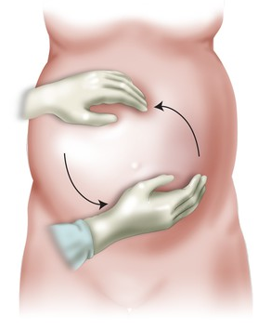
PHASE 3
37 to 41 Weeks Recommendations con’t
7.0 Offer external cephalic version (ECV) in cases of breech presentation before term when appropriate
  Fetal presentations should be documented at 36+0w
  ECV for breech presentation should be offered at 37w
  Regional analgesia may enhance ECV
  Continue mentorship in training ECV with obstetric and midwifery providers
8.0 Establish standard protocols for IOL
Notes:
8.0
For example, booking process in a hospital for inductions.

Slide 26
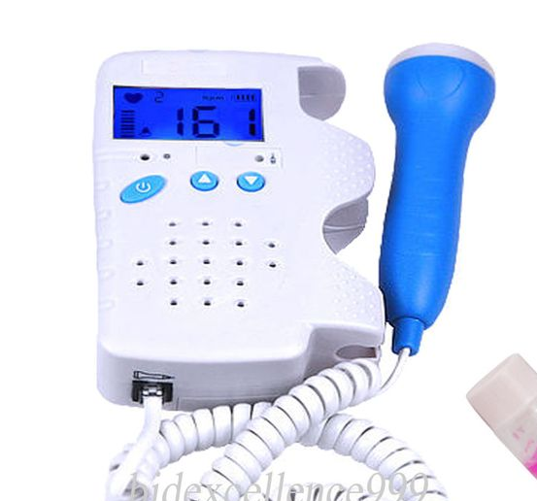
Management of Labour Recommendations
PHASE 4
9.0 Support management of latent phase (prior to established active labour) and delay hospital admission until labour is established
  Delay admitting until active labor and inform women of risks of admission prior to active labor
  Electronic fetal monitoring (EFM) should be avoided, assess with IA
  Provide information on pain management or alternatives
10.0 Provide one-to-one support during active labour
Notes:
10.0
Involve supportive partner during active labor

Slide 27
PHASE 4
Management of Labour Recommendations con’t
11.0 Perform assessment of fetal wellbeing using evidenced based methods
  IA is preferred as it has lower intervention rate than EFM
  With an epidural in place, it is safe to use IA to monitor
12.0 Perform assessment for fetal well-being in the presence of abnormal or atypical fetal heart rate tracing
  Scalp stimulation can provide indirect assessment of acid-base status
  Fetal scalp sampling at gestations >34w
  Amnioinfusion for repetitive variable decels may safely reduce rate of CS
Notes:
11.0
With a protocol in place, IA can be done prior to and following epidural analgesia (e.g., q5minx30mins after epidural insertion and following top ups if VSS)
12.0
When amnioinfusion is not readily available, one may consider to delay artificial rupture of membranes (AROM)

Slide 28
PHASE 4
Management of Labour Recommendations con’t
13.0 Management of abnormal first stage and second stage of labour
  A prolonged latent phase should not be an indication for CS
  Active labor at 4cm dilated; prior to 4cm active phase should not be applied
  Benefits of upright positioning of women in labor
  Augmentation with oxytocin for up to 8hrs in first stage of labor
  Waiting for up to 2hrs prior to the onset of pushing is OK
  Push for 3hrs with an epidural; 2hrs without

Slide 29
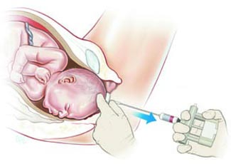
PHASE 4
Management of Labour Recommendations con’t
  13.0 Management of abnormal first stage and second stage of labour
  No maximum time for second stage has been identified
  Assisted Vaginal Delivery (AVD) not recommended at less than 2hrs after commencing pushing
  Support training of skills related to AVD
  In the setting of fetal malposition consider manual rotation of the fetal occiput
>2 hours

Slide 30
Post-Delivery Management Recommendations
PHASE 5
14.0 - Use evidence based approaches for post-delivery management to promote optimal outcomes and reduced length of hospital stay
  Newborns skin to skin for at least one hour
  Multimodal co-analgesics should be used to manage pain and encourage early ambulation
  Surgical site infection prevention and venous thromboembolism prophylaxis
15.0 - Discuss the option of vaginal birth in the subsequent pregnancy with women who had a CS
Notes:
14.0
Regardless of the mode of delivery, newborns should be placed in uninterrupted skin-to-skin contact with their mothers immediately following birth for at least an hour or until completion of the first feeding or as long as the mother wishes. If skin-to-skin contact between the newborn and the mother is not possible, a partner can also be used.
Hospitals should adopt and implement evidenced based guidelines (e.g., SOGC) for discharge after vaginal birth and after CS. This is intended to promote optimal length of stay and early discharge when appropriate, as well as better outcomes for mother and newborn.
Intraoperative epidural/ intrathecal morphine and post-operative multimodal co-analgesics should be used to improve post-operative pain management and encourage early ambulation.
Evidence-based practices should be followed with respect to surgical site infection prevention
Clinical practice guidelines should be followed for venous thromboembolism prophylaxis

Slide 31

Retrospective Evaluation/Review Recommendations
PHASE 6
16.0 Each hospital to establish an interdisciplinary committee to monitor and review performance metrics
  Review number of post date IOL before 41w and whether it was medically indicated
  Hospitals should review CS rate by health care provider and identify opportunities for improvement
  CS and all QBP metrics should be shared publically to promote quality improvement
  LHINs should monitor hospital performance. PCMCH, via the LHINs or local regional maternal-child networks may act as a support to hospitals in enlisting mentorship support.
Notes:
16.0
Establish hospital processes to review the number of postdates inductions taking place before 41 weeks of gestation. The BORN Ontario Maternal-Newborn Dashboard KPI#6 measures whether inductions for post-dates happened at the appropriate time, based on the gestational age when birth occurred.
Hospitals should review the CS rate and rate variation by provider to identify opportunities for improvement.
CS and all other QBP metrics will be shared publically in an open and transparent manner to promote quality improvement.
LHINs should monitor hospital performance based on the established indicators. Where hospitals are consistently unable to meet established performance metrics, LHINs should consider progressive performance improvement steps, such as coaching or mentoring by peer hospital organizations. PCMCH may act as support to LHINs and hospitals in enlisting mentorship support, such as regional network utilization.

Slide 32
QBP for Low Risk Birth Implementation

Slide 33

Implementation
Identify a site champion to integrate recommendations in hospital policies and procedures
Convene an implementation team that may include: administrative leads, physicians, midwives, clinical practice leads, nursing, decision support, executive sponsor, communications strategist and patient representative
Conduct current state/gap analysis
Review quality indicators
Notes:
Identification of a site lead/champion who will be responsible for:
Adapting the documents to meet hospital formatting requirements;
Leading the pathway and recommendations through the necessary hospital approval committees;
Discussing the recommendations and implications with a interdisciplinary team members (nurses, obstetricians, midwives, family physicians);
Organizing education/training sessions and identifying other resources to support uptake of the recommendations.

Slide 34
Implementation Teams Role
Review LRB Pathway
Develop Operational Strategy
Review Progress through Reporting
Integrate into Institutional Practices
Identify Area for Improvement
Audit and Feedback
Engage and Promote Experience with others
Notes:
Convening a small implementation team, including the previously mentioned lead, to provide oversight in the implementation process, including:
Detailed review of the Low Risk Birth Pathway recommendations, including the quality indicators, and the funding and volume impact;
Current state assessment and pathway gap analysis on comparison with current institutional and individual practices;
Development of an organizational vision, including the identification of opportunities for improvement;
Development of an operational strategy to ensure optimal environment for care based on the institution’s local circumstances, unique clinical team compositions and available staffing capacities and resources;
Discussion of feasible changes for that institution, including outcome measures and targets, and timelines for completion;
Progress reports to ensure accountability to hospital administration;
Audit and feedback of pathway use;
Engagement with peers to promote sharing of implementation experiences and insights.

Slide 35

Quality Indicators
The Better Outcomes Registry & Network (BORN) Ontario is developing a data report to support the implementation of clinical best practices with respect to low risk birth.
This report will be an important resource to monitor implementation and progress across the province.
Report development has been initiated and work will be ongoing in FY2018-19.

Slide 36

© 2018 Provincial Council for Maternal and Child Health
Materials contained within this publication are copyright by the Provincial Council for Maternal and Child Health. Publications are intended for dissemination within and use by clinical networks. Reproduction or use of these materials for any other purpose requires the express written consent of the Provincial Council for Maternal and Child Health. Anyone seeking consent to reproduce materials in whole or in part, must seek permission of the Provincial Council for Maternal and Child Health by
contacting info@pcmch.on.ca.
Provincial Council for Maternal and Child Health
555 University Avenue
Toronto, ON, M5G 1X8
info@pcmch.on.ca

